Slide 1

Understanding the Delivery Delay of Addressed Issues in Large Software Projects
Candidate: Daniel Alencar da Costa
Advisors: Uirá Kulesza and Ahmed E. Hassan

Slide 2



Attracting and retaining the interest of users is a key factor for a software project’s success
Motivation
1

Slide 3

Within a globalized world, it is common to see globally spread teams
Motivation
2

Slide 4



Such teams use Issue Tracking Systems control the progress of their tasks
Motivation
3

Slide 5



A software issue can either describe a bug, an enhancement, or a new feature
Motivation
Bug fix
New feature
Enhancement
4

Slide 6

The state of an issue changes from ‘reported’ to ‘fixed’ as it progresses until delivery
Motivation
Reported
5

Slide 7

The state of an issue changes from ‘reported’ to ‘fixed’ as it progresses until delivery
Motivation
Reported
Fixed
5

Slide 8
Although an issue has been addressed, users may still wait some time to experience it
Problem
6

Slide 9
Although an issue has been addressed, users may still wait some time to experience it
Problem
Reported
Fixed
6

Slide 10

Although an issue has been addressed, users may still wait some time to experience it
Problem
User
Reported
Fixed
6

Slide 11
Although an issue has been addressed, users may still wait some time to experience it
Problem
User
Reported
Fixed
Still…
6

Slide 12
Although an issue has been addressed, users may still wait some time to experience it
Problem
User
Reported
Fixed
Delivered!
6

Slide 13

Much effort has been invested on studying the needed time to address an issue
Current limitations
7
Notes:
Mencionar um ou outro que sejam os mais proximos do trabalho. Ver se vale a pena encaixar Outra possibilidade é deixar pro final e falar de related work (botar pro final no slide de related work é melhor)

Slide 14

However, studying the required time to deliver addressed issues remains as an open challenge
Current limitations
8

Slide 15
Agenda
Thesis
Proposal
Background
Studies
Final Remarks
9

Slide 16
Agenda
Thesis
Proposal
Background
Studies
Final Remarks
9

Slide 17
Agenda
Thesis
Proposal
Background
Studies
Final Remarks
9

Slide 18
Agenda
Thesis
Proposal
Background
Studies
Final Remarks
9

Slide 19
Agenda
Thesis
Proposal
Background
Studies
Final Remarks
9

Slide 20
Agenda
Thesis
Proposal
Background
Studies
Final Remarks
9

Slide 21
We perform three studies towards the general question: what leads to delivery delay?
Thesis proposal
10

Slide 22
We perform three studies towards the general question: what leads to delivery delay?
Thesis proposal
Quantitative
Reasons
For
Delay
Impact of
Release
Strategies
Qualitative
10
Notes:
Vale a pena ocupar um espaço maior nos slides

Slide 23
We perform three studies towards the general question: what leads to delivery delay?
Thesis proposal
Quantitative
Study 1: How frequent is delivery delay?
Reasons
For
Delay
Impact of
Release
Strategies
Qualitative
10
Notes:
Vale a pena ocupar um espaço maior nos slides

Slide 24
We perform three studies towards the general question: what leads to delivery delay?
Thesis proposal
Quantitative
Study 1: How frequent is delivery delay?
Study 2: Do rapid releases reduce delivery delays?
Reasons
For
Delay
Impact of
Release
Strategies
Qualitative
10
Notes:
Vale a pena ocupar um espaço maior nos slides

Slide 25
We perform three studies towards the general question: what leads to delivery delay?
Thesis proposal
Quantitative
Study 1: How frequent is delivery delay?
Study 2: Do rapid releases reduce delivery delays?
Reasons
For
Delay
Impact of
Release
Strategies
Study 3: Why do delivery delays occur?
Qualitative
10
Notes:
Vale a pena ocupar um espaço maior nos slides

Slide 26
Agenda
Thesis
Proposal
Background
Studies
Final Remarks
11

Slide 27
Agenda
Thesis
Proposal
Background
Studies
Final Remarks
11

Slide 28
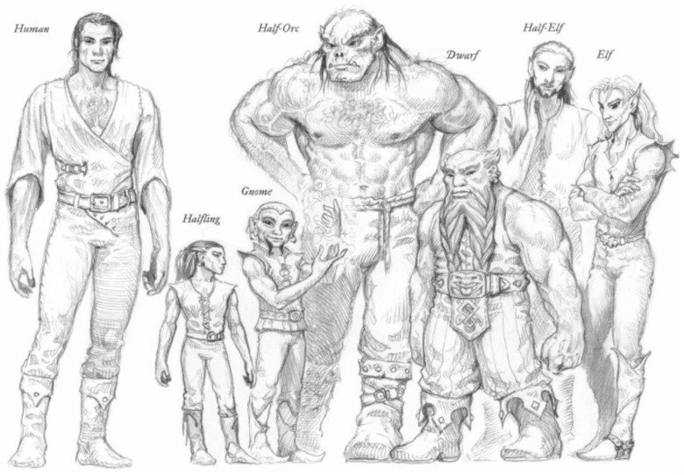
We study different types of delivery delay
Background
12

Slide 29
Type 1 – the number of releases that are shipped before an issue is delivered
Background
13

Slide 30

Type 1 – the number of releases that are shipped before an issue is delivered
Background
1.0
2.0
3.0
13

Slide 31

Type 1 – the number of releases that are shipped before an issue is delivered
Background
1.0
2.0
3.0
13

Slide 32

Type 1 – the number of releases that are shipped before an issue is delivered
Background
1.0
2.0
3.0
13

Slide 33
Type 1 – the number of releases that are shipped before an issue is delivered
Background
1.0
2.0
3.0
13

Slide 34
Type 1 – the number of releases that are shipped before an issue is delivered
Background
Delivered after one release
1.0
2.0
3.0
13

Slide 35
Type 2 – the number of days that are required to ship an addressed issue
Background
14

Slide 36
Type 2 – the number of days that are required to ship an addressed issue
Background
1.0
2.0
3.0
14

Slide 37
Type 2 – the number of days that are required to ship an addressed issue
Background
1.0
2.0
3.0
14

Slide 38
Type 2 – the number of days that are required to ship an addressed issue
Background
65 days
1.0
2.0
3.0
14

Slide 39
Type 3 – the most prolonged delays of a given project
Background
15

Slide 40
Type 3 – the most prolonged delays of a given project
Background
300
100
50
0
IDs
15

Slide 41
Type 3 – the most prolonged delays of a given project
Background
300
100
50
0
IDs
15

Slide 42
Type 3 – the most prolonged delays of a given project
Background
300
100
Median
50
0
IDs
15

Slide 43
Type 3 – the most prolonged delays of a given project
Background
300
100
MAD
Median
50
0
IDs
15

Slide 44
Type 3 – the most prolonged delays of a given project
Background
Prolonged!
300
100
MAD
Median
50
0
IDs
15

Slide 45
Release cycle: is the time period that the development team takes to ship a new release
Background
16

Slide 46
Release cycle: is the time period that the development team takes to ship a new release
Background
1.0
2.0
3.0
16

Slide 47
Release cycle: is the time period that the development team takes to ship a new release
Background
Release Cycle I
Release Cycle II
1.0
2.0
3.0
16

Slide 48
Agenda
Thesis
Proposal
Background
Studies
Final Remarks
16

Slide 49
Agenda
Thesis
Proposal
Background
Studies
Final Remarks
16

Slide 50

How frequent is delivery delay?
Study 1

Slide 51
There is a lack of empirical research that investigate the frequency of delivery delays
Motivation
18

Slide 52

There is a lack of empirical research that investigate the frequency of delivery delays
Motivation
We must have more evidences…
18

Slide 53
This study is also motivated by investigating the factors that lead to prolonged delays
Motivation
19

Slide 54

This study is also motivated by investigating the factors that lead to prolonged delays
Motivation
It would be very useful if we could avoid prolonged delays
19

Slide 55



We set out to empirically study 20.995 addressed issues from the Firefox, ArgoUML, and Eclipse projects
Empirical study
Firefox
Eclipse
ArgoUML
20

Slide 56
We perform the following analyses
Empirical study
21

Slide 57
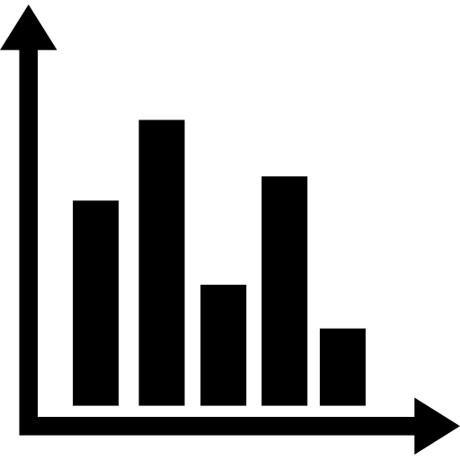
We perform the following analyses
Empirical study
Frequency
21
Notes:
Botar mais um pouco da metodologia de cada estudo, pois de repente fica parecendo simples. ESPECIALMENTE PARA O ESTUDO QUALITATIVO, da a impressao de ter sido um estudo bem simples.

Slide 58

We perform the following analyses
Empirical study
Frequency
Explore factors
21
Notes:
Comment the use of regression model and statistical analysis

Slide 59

We perform the following analyses
Empirical Study
Frequency
Explore factors
Prolonged delays
21

Slide 60
We perform the following analyses
Empirical Study
Frequency
Explore factors
Prolonged delays
21

Slide 61
34% to 98% of addressed issues had their integration prevented from at least one release
RQ1 – How often are addressed issues prevented from shipping?
22

Slide 62
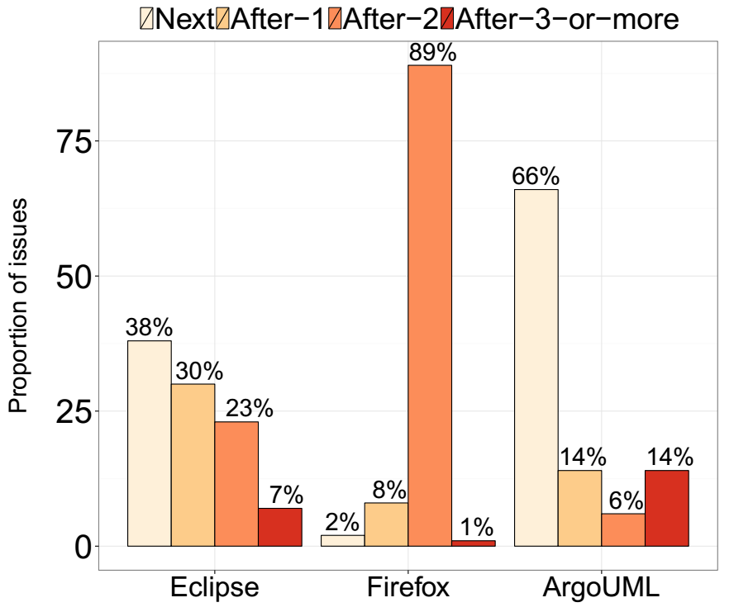
34% to 98% of addressed issues had their integration prevented from at least one release
RQ1 – How often are addressed issues prevented from shipping?
22

Slide 63
34% to 98% of addressed issues had their integration prevented from at least one release
RQ1 – How often are addressed issues prevented from shipping?
60%
22

Slide 64
34% to 98% of addressed issues had their integration prevented from at least one release
RQ1 – How often are addressed issues prevented from shipping?
34%
22

Slide 65
Issues are being addressed well before an upcoming release
RQ1 – How often are addressed issues prevented from shipping?
23

Slide 66
Issues are being addressed well before an upcoming release
RQ1 – How often are addressed issues prevented from shipping?
Fix Timing
23

Slide 67
Issues are being addressed well before an upcoming release
RQ1 – How often are addressed issues prevented from shipping?
Fix Timing
23

Slide 68
Issues are being addressed well before an upcoming release
RQ1 – How often are addressed issues prevented from shipping?
# of days before a release
Fix Timing
23

Slide 69
Issues are being addressed well before an upcoming release
RQ1 – How often are addressed issues prevented from shipping?
# of days before a release
Fix Timing
release cycle duration
23

Slide 70
Issues are being addressed well before an upcoming release
RQ1 – How often are addressed issues prevented from shipping?
# of days before a release
Fix Timing
60 days
23

Slide 71
Issues are being addressed well before an upcoming release
RQ1 – How often are addressed issues prevented from shipping?
30 days
Fix Timing
60 days
23

Slide 72
Issues are being addressed well before an upcoming release
RQ1 – How often are addressed issues prevented from shipping?
30 days
Fix Timing
0.5
60 days
23

Slide 73
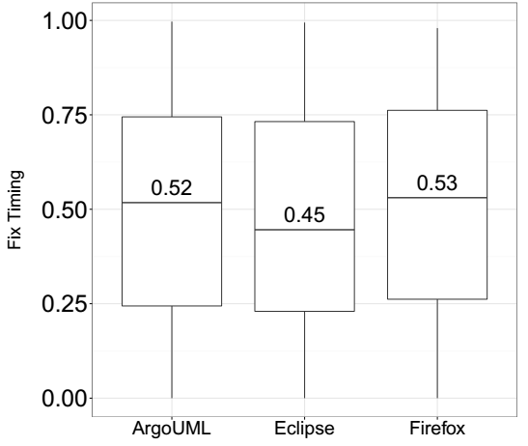
Issues are being addressed well before an upcoming release
RQ1 – How often are addressed issues prevented from shipping?
24

Slide 74
Issues that are addressed during more stable stages of a release cycle tends to have shorter delays
RQ2 – Does the stage of the release cycle impact delivery delay?
25

Slide 75
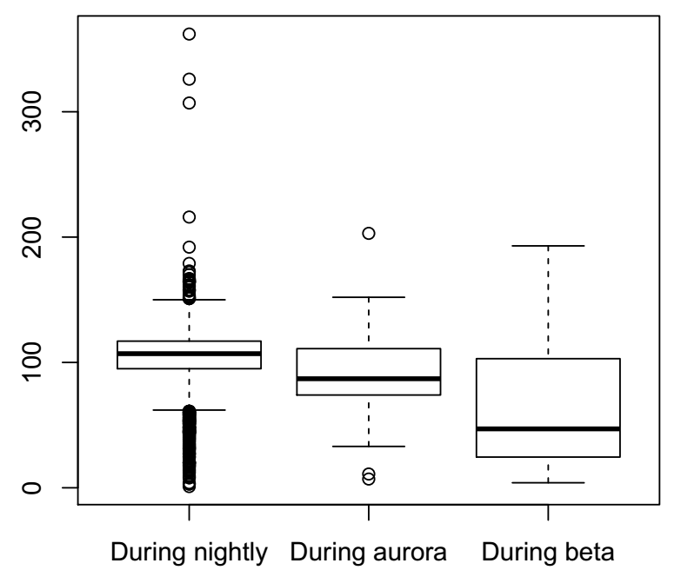
Issues that are addressed during more stable stages of a release cycle tends to have shorter delays
RQ2 – Does the stage of the release cycle impact delivery delay?
26

Slide 76
Empirical Study
Frequency
Explore factors
Prolonged delays
27

Slide 77
Empirical Study
Frequency
Explore factors
Prolonged delays
Indeed, delivery delay is frequent
27

Slide 78
Empirical Study
Frequency
Explore factors
Prolonged delays
Indeed, delivery delay is frequent
27

Slide 79
We collect many factors that are computed using code repositories and issue tracking systems
RQ3 – How well can we model the delivery delay of addressed issues?
28

Slide 80

We collect many factors that are computed using code repositories and issue tracking systems
RQ3 – How well can we model the delivery delay of addressed issues?
Number of Impacted Files
28

Slide 81

We collect many factors that are computed using code repositories and issue tracking systems
RQ3 – How well can we model the delivery delay of addressed issues?
Number of Impacted Files
Number of comments
I Think this bug is due to…
28

Slide 82


We collect many factors that are computed using code repositories and issue tracking systems
RQ3 – How well can we model the delivery delay of addressed issues?
Number of Impacted Files
Number of comments
Experience of the resolvers
I Think this bug is due to…
VS
28

Slide 83
Then, we analyze both delivery delay in terms of number of releases and days
RQ3 – How well can we model the delivery delay of addressed issues?
29

Slide 84
Then, we analyze both delivery delay in terms of number of releases and days
RQ3 – How well can we model the delivery delay of addressed issues?
AUCs
0.62 – 0.96
0.39 – 0.65
R²
29

Slide 85
The time invested on addressing issues and workload factors play an influential role to model delay in terms of releases
RQ4 – What are the most influential factors for modeling delivery delay?
30

Slide 86
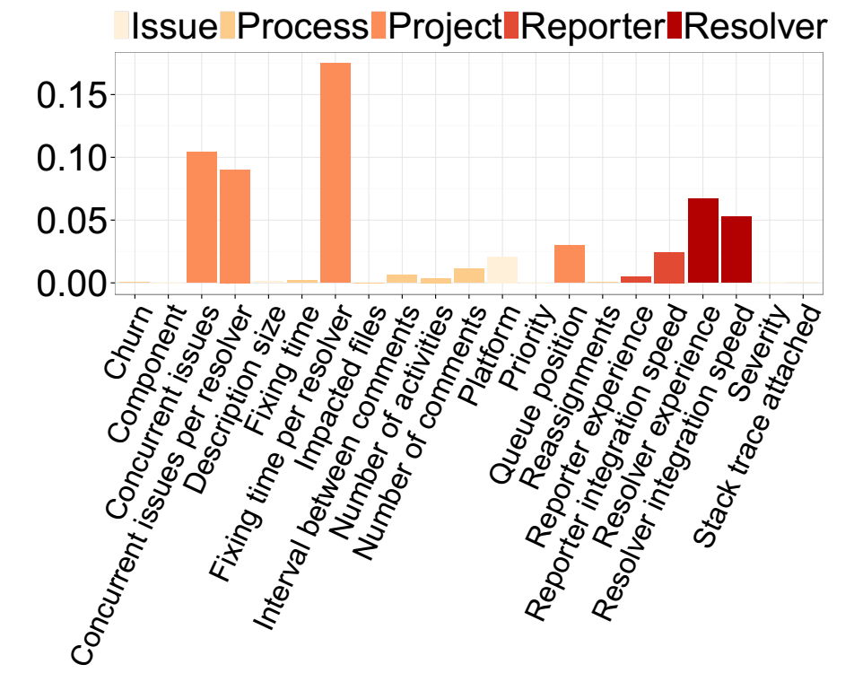
The time invested on addressing issues and workload factors play an influential role to model delay in terms of releases
RQ4 – What are the most influential factors for modeling delivery delay?
30

Slide 87
Severity and priority levels have little influence on the delivery delay in terms of releases
RQ4 – What are the most influential factors for modeling delivery delay?
31

Slide 88
The time at which issues are addressed during a release cycle plays a major role in modeling delay in terms of days
RQ4 – What are the most influential factors for modeling delivery delay?
32

Slide 89
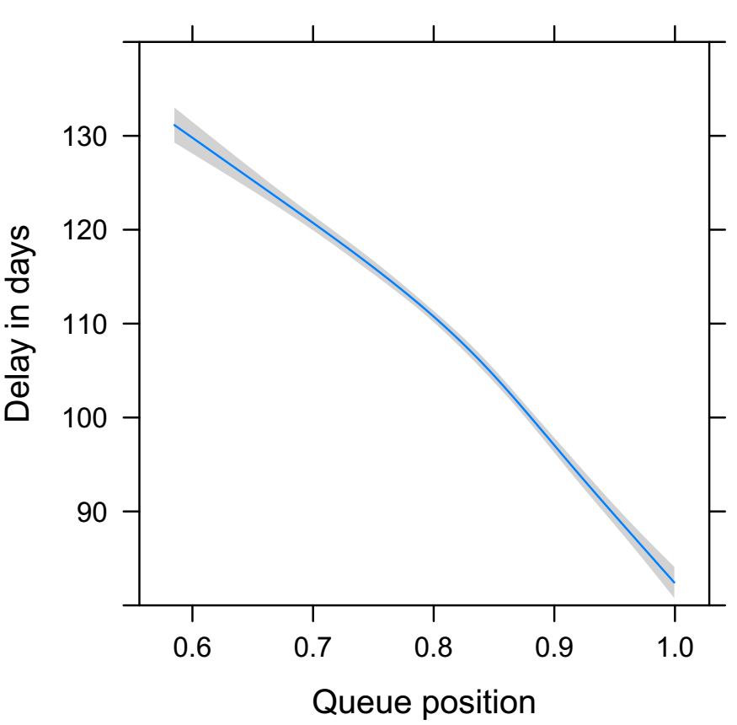
The time at which issues are addressed during a release cycle plays a major role in modeling delay in terms of days
RQ4 – What are the most influential factors for modeling delivery delay?
32

Slide 90
Empirical Study
Frequency
Explore factors
Prolonged delays
Indeed, delivery delay is frequent
33

Slide 91
Empirical Study
Frequency
Explore factors
Prolonged delays
Indeed, delivery delay is frequent
Project factors are the most important
33

Slide 92
Empirical Study
Frequency
Explore factors
Prolonged delays
Indeed, delivery delay is frequent
Project factors are the most important
33

Slide 93
The proportion of issues that suffered from prolonged delays is under 25% for each dataset
RQ5 – How well can we identify issues that will suffer from a prolonged delay?
34

Slide 94
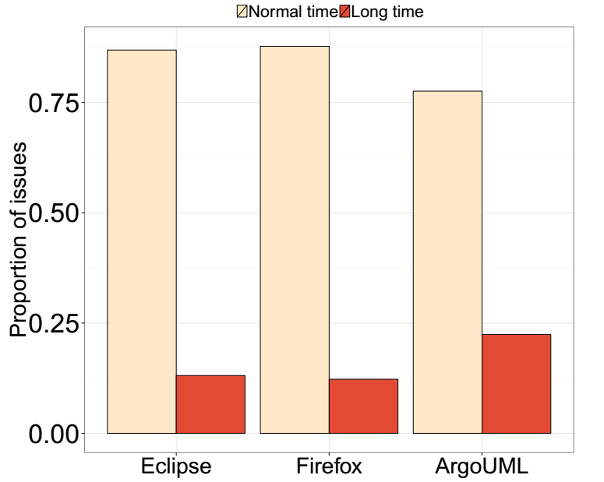
The proportion of issues that suffered from prolonged delays is under 25% for each dataset
RQ5 – How well can we identify issues that will suffer from a prolonged delay?
34

Slide 95
Our statistical models achieve a good fit
RQ5 – How well can we identify issues that will suffer from a prolonged delay?
AUCs
0.82 – 0.96
35

Slide 96
Project factors are most important to model prolonged delays
RQ6 – What are the most influential factors to model prolonged delays?
36

Slide 97
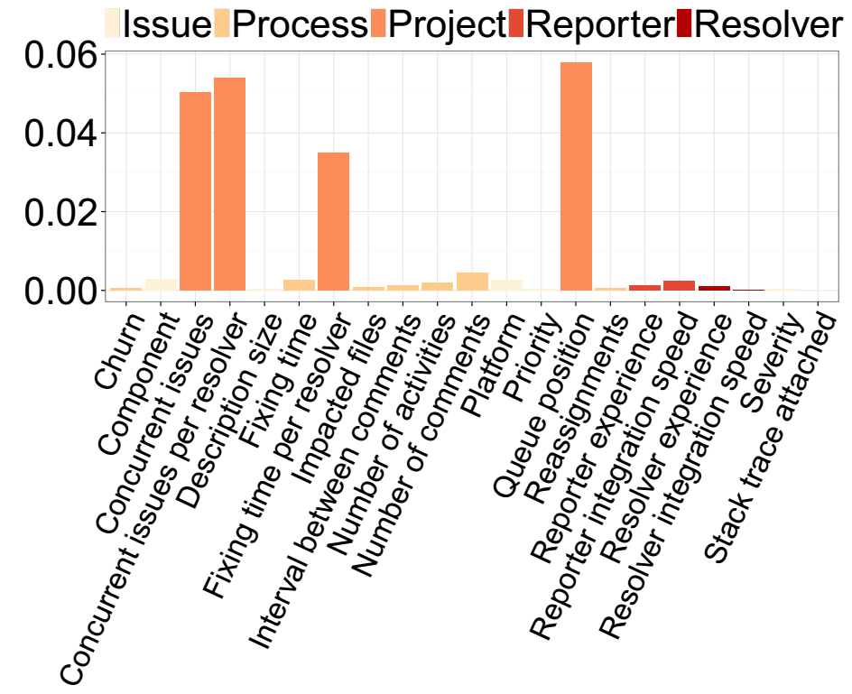
Project factors are most important to model prolonged delays
RQ6 – What are the most influential factors to model prolonged delays?
37

Slide 98
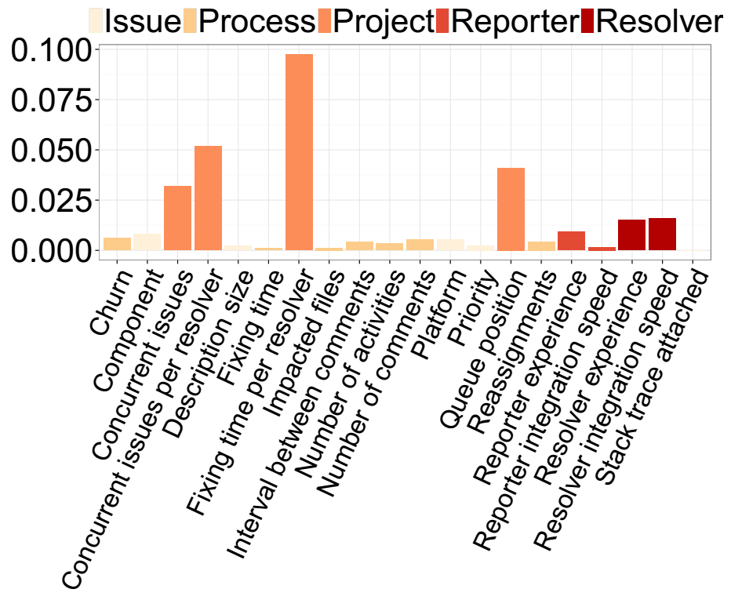
Project factors are most important to model prolonged delays
RQ6 – What are the most influential factors to model prolonged delays?
37

Slide 99
Empirical Study
Frequency
Explore factors
Prolonged delays
Indeed, delivery delay is frequent
Project factors are the most important
38

Slide 100
Empirical Study
Frequency
Explore factors
Prolonged delays
Indeed, delivery delay is frequent
Project factors are the most important
Again… project factors are the most important
38

Slide 101

Delivery delays represent an overhead that development teams need to manage
Conclusions
39

Slide 102
Do rapid releases reduce delivery delays?
Study 2

Slide 103

The allure of delivering new features more quickly has led many projects to adopt rapid release cycles
Motivation
40

Slide 104
However, the speed at which features are delivered using rapid releases still needs to be empirically checked
Motivation
Uh oh… again,
no evidences…
41

Slide 105


We set out to empirically compare the delivery delay of traditional and rapid releases of the Firefox project
Empirical study
VS
Traditional
Rapid
111 releases
73 releases
34,673 issues
37,443 issues
1.0 to 4.0
10 to 27
42

Slide 106
We perform the following analyses
Empirical study
43

Slide 107
We perform the following analyses
Empirical study
vs
Comparing delivery delays
43

Slide 108
We perform the following analyses
Empirical study
vs
3.6
3.6.1
3.6.2
Comparing delivery delays
Major vs minor releases
43

Slide 109
We perform the following analyses
Empirical study
vs
3.6
3.6.1
3.6.2
Comparing delivery delays
Major vs minor releases
Analyzing important factors
43
Notes:
Again emphisize the use of statistical models

Slide 110
We perform the following analyses
Empirical study
vs
3.6
3.6.1
3.6.2
Comparing delivery delays
Major vs minor releases
Analyzing important factors
43

Slide 111
Although issues are fixed more quickly in rapid releases, they are delivered more slowly
RQ1 – Are addressed issues delivered more quickly in rapid releases?
44

Slide 112
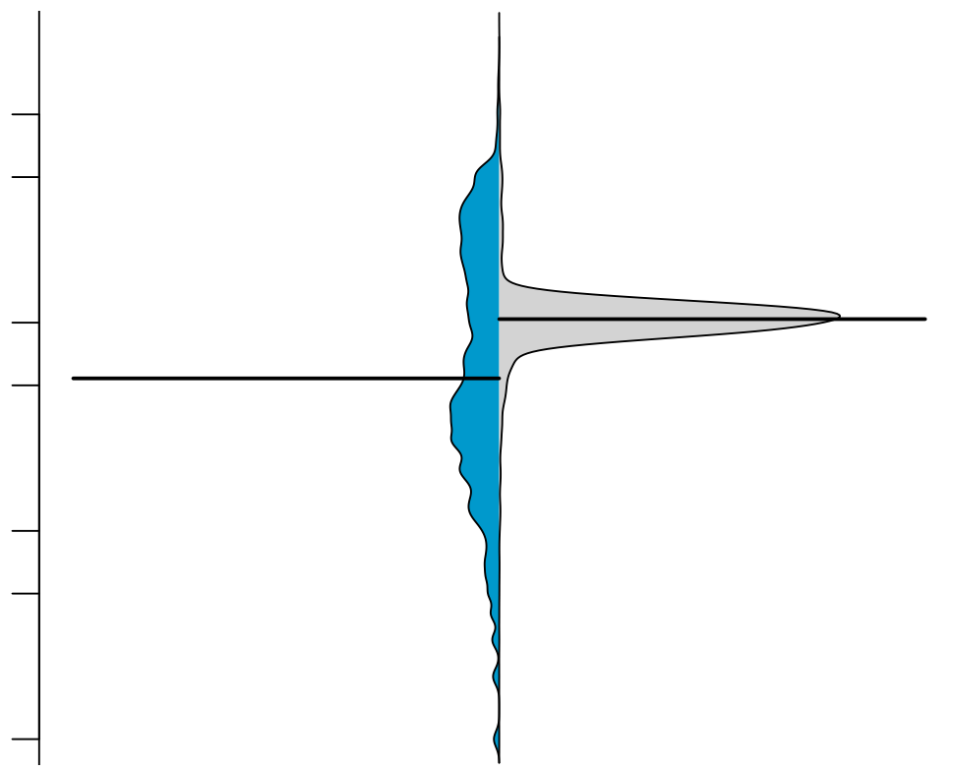
Although issues are fixed more quickly in rapid releases, they are delivered more slowly
RQ1 – Are addressed issues delivered more quickly in rapid releases?
500
Rapid
Traditional
50
Days to deliver fixed issues
5
1
44

Slide 113
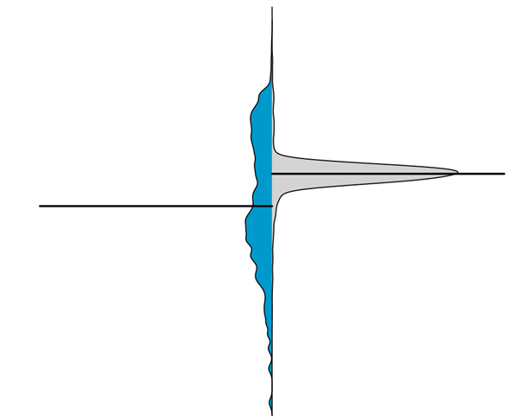


Fixed issues are delivered more consistently in rapid releases
RQ1 – Are addressed issues delivered more quickly in rapid releases?
I have consistent gains!
I can be faster!
Rapid
Traditional
45

Slide 114
Empirical study
vs
3.6
3.6.1
3.6.2
Comparing delivery delays
Major vs minor releases
Analyzing important factors
46

Slide 115
Empirical study
vs
3.6
3.6.1
3.6.2
Comparing delivery delays
Major vs minor releases
Analyzing important factors
Rapid releases are not ‘that rapid’
46

Slide 116
Empirical study
vs
3.6
3.6.1
3.6.2
Comparing delivery delays
Major vs minor releases
Analyzing important factors
Rapid releases are not ‘that rapid’
46

Slide 117
Minor releases: a key reason as to why traditional releases can deliver fixed issues more quickly
RQ2 – Why can traditional releases deliver addressed issues more quickly?
47

Slide 118
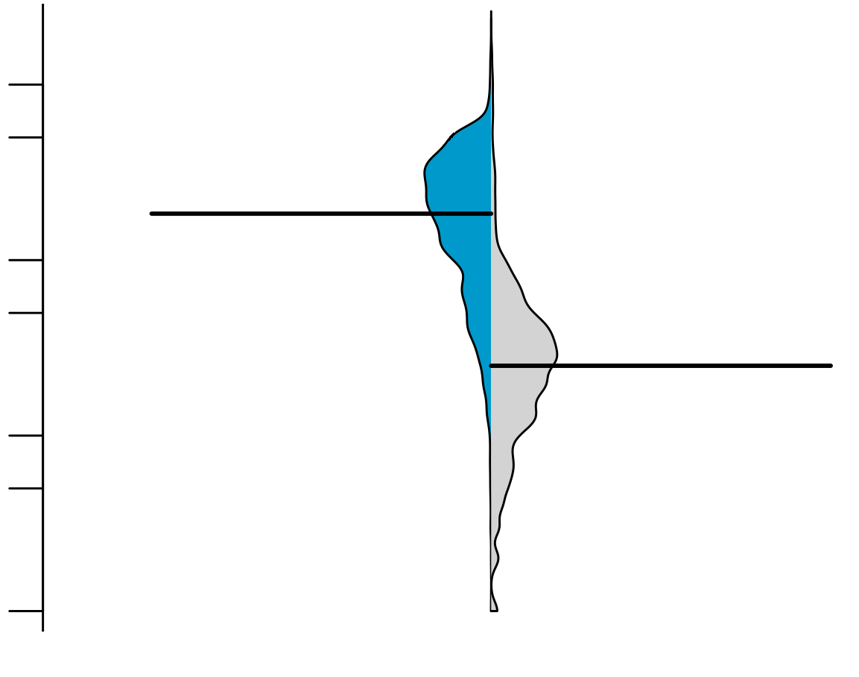
Minor releases: a key reason as to why traditional releases can deliver fixed issues more quickly
RQ2 – Why can traditional releases deliver addressed issues more quickly?
500
Major
traditional
Minor
traditional
50
Days to deliver fixed issues
5
1
47

Slide 119
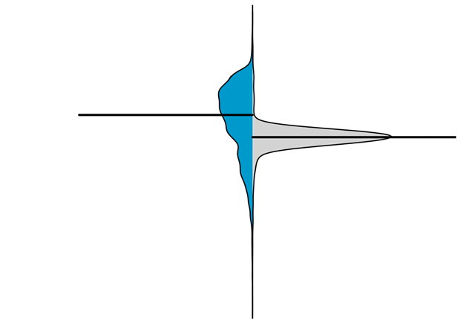
Minor releases: a key reason as to why traditional releases can deliver fixed issues more quickly
RQ2 – Why can traditional releases deliver addressed issues more quickly?
500
Major
traditional
Major
traditional
Rapid
Minor
traditional
50
Days to deliver fixed issues
5
1
47

Slide 120
Empirical study
vs
3.6
3.6.1
3.6.2
Comparing delivery delays
Major vs minor releases
Analyzing important factors
Rapid releases are not ‘that rapid’
48

Slide 121
Empirical study
vs
3.6
3.6.1
3.6.2
Comparing delivery delays
Major vs minor releases
Analyzing important factors
Rapid releases are not ‘that rapid’
Minor releases quicken the delivery time
48

Slide 122
Empirical study
vs
3.6
3.6.1
3.6.2
Comparing delivery delays
Major vs minor releases
Analyzing important factors
Rapid releases are not ‘that rapid’
Minor releases quicken the delivery time
49

Slide 123
As in Study 1, we collect several factors that we suspect to share a relationship with delivery delay
RQ3 – Does the release strategy have an impact on delivery delay factors?
50

Slide 124
Prioritization is different among release strategies
RQ3 – Does the release strategy have an impact on delivery delay factors?
51

Slide 125
Prioritization is different among release strategies
RQ3 – Does the release strategy have an impact on delivery delay factors?
2.0
3.0
Traditional
51

Slide 126
Prioritization is different among release strategies
RQ3 – Does the release strategy have an impact on delivery delay factors?
2.0
3.0
Backlog of issues
Traditional
51

Slide 127
Prioritization is different among release strategies
RQ3 – Does the release strategy have an impact on delivery delay factors?
2.0
3.0
Traditional
51

Slide 128
Prioritization is different among release strategies
RQ3 – Does the release strategy have an impact on delivery delay factors?
Position 4 in the backlog
2.0
3.0
Traditional
51

Slide 129

Prioritization is different among release strategies
RQ3 – Does the release strategy have an impact on delivery delay factors?
Position 4 in the backlog
0.95
2.0
3.0
0.90
0.85
0.80
Traditional
0
5,000
10,000
Position in the backlog
51

Slide 130
Prioritization is different among release strategies
RQ3 – Does the release strategy have an impact on delivery delay factors?
Position 4 in the backlog
0.95
2.0
3.0
0.90
0.85
0.80
Traditional
0
5,000
10,000
Position in the backlog
2.0
3.0
Release cycle backlog
Rapid
51

Slide 131
Prioritization is different among release strategies
RQ3 – Does the release strategy have an impact on delivery delay factors?
Position 4 in the backlog
0.95
2.0
3.0
0.90
0.85
0.80
Traditional
0
5,000
10,000
Position in the backlog
Position 2 in the cycle backlog
2.0
3.0
Rapid
51

Slide 132
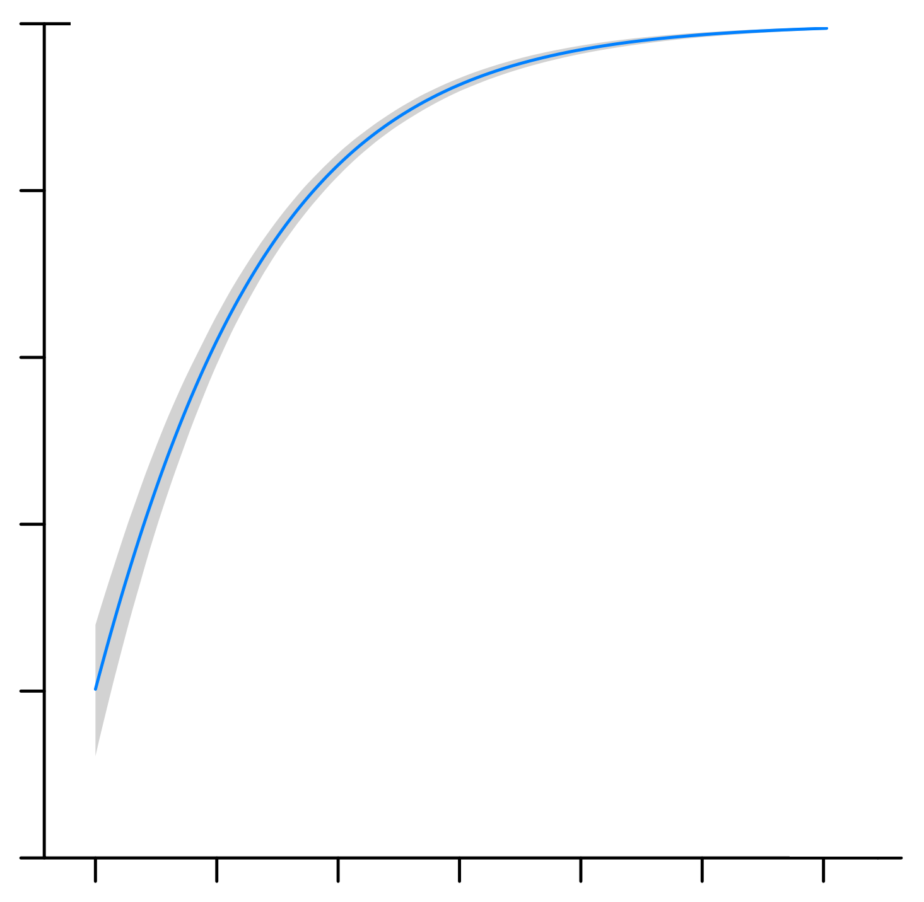
Prioritization is different among release strategies
RQ3 – Does the release strategy have an impact on delivery delay factors?
Position 4 in the backlog
0.95
2.0
3.0
0.90
0.85
0.80
Traditional
0
5,000
10,000
Position in the backlog
0.95
Position 2 in the cycle backlog
0.90
2.0
3.0
0.85
0.80
1,000
Rapid
0
3,000
Position in the cycle backlog
51

Slide 133
Traditional releases behave as a queue while rapid releases behave as a stack
RQ3 – Does the release strategy have an impact on delivery delay factors?
52

Slide 134
Traditional releases behave as a queue while rapid releases behave as a stack
RQ3 – Does the release strategy have an impact on delivery delay factors?
VS
52

Slide 135
Traditional releases behave as a queue while rapid releases behave as a stack
RQ3 – Does the release strategy have an impact on delivery delay factors?
1.0
2.0
3.0
VS
52

Slide 136
Traditional releases behave as a queue while rapid releases behave as a stack
RQ3 – Does the release strategy have an impact on delivery delay factors?
Released
Completed
1.0
2.0
3.0
VS
52

Slide 137
Traditional releases behave as a queue while rapid releases behave as a stack
RQ3 – Does the release strategy have an impact on delivery delay factors?
Released
Completed
1.0
2.0
3.0
VS
3.0
2.0
1.0
52

Slide 138
Traditional releases behave as a queue while rapid releases behave as a stack
RQ3 – Does the release strategy have an impact on delivery delay factors?
Released
Completed
1.0
2.0
3.0
VS
Released
Completed
3.0
2.0
1.0
52

Slide 139
Empirical study
vs
3.6
3.6.1
3.6.2
Comparing delivery delays
Major vs minor releases
Analyzing important factors
Rapid releases are not ‘that rapid’
Minor releases quicken the delivery time
53

Slide 140
Empirical study
vs
3.6
3.6.1
3.6.2
Comparing delivery delays
Major vs minor releases
Analyzing important factors
Rapid releases are not ‘that rapid’
Minor releases quicken the delivery time
Different prioritization
53

Slide 141

A rapid release strategy is not a silver bullet to reduce delivery delay
Conclusions
54

Slide 142
Why do Delivery Delays Occur?
Study 3

Slide 143

Reach deeper knowledge that was gained through quantitative analysis
Motivation
55

Slide 144

Verify to which extent our quantitative findings can be confirmed by our participants
Motivation
56
Notes:
Fazer uma reflexao no final atraves dos dois objetivos. Qual foi a vantage de ter usado o metodo qualitative?

Slide 145

We survey 37 participants from the Firefox, ArgoUML, and Eclipse projects
Empirical study
57
Notes:
We also perform 4 follow up interviews with participants that were willing to do so

Slide 146

We performs an extensive Open Coding analysis that generated 175 unique codes
Empirical study
58
Notes:
We also perform 4 follow up interviews with participants that were willing to do so

Slide 147
We perform the following analyses
Empirical study
59

Slide 148

We perform the following analyses
Empirical study
General perceptions
60
Notes:
Valorizar bem a metodologia aqui, detalhar bem mais. Pode ressaltar que usually we have executed regression analysis, statistical tests. -> dar mais brilho

Slide 149

We perform the following analyses
Empirical study
General perceptions
Impressions about rapid releases
60

Slide 150

We perform the following analyses
Empirical study
General perceptions
Impressions about rapid releases
Do our findings make sense?
60

Slide 151
We perform the following analyses
Empirical study
General perceptions
Impressions about rapid releases
Do our findings make sense?
60
Notes:
Sempre interessante confrontar com os resultados quantitativos e qualitativos

Slide 152
The most recurrent themes are ‘development activities’, ‘decision making’, ‘risk’, ‘frustration’, and ‘team collaboration’
RQ1 – What are developers’ perceptions as to why delivery delay occur?
61

Slide 153
Additional testing is one of the main perceived reasons as to why delivery delay occurs
Development activities
61

Slide 154
Additional testing is one of the main perceived reasons as to why delivery delay occurs
Development activities
Lack of “actual user testing beyond what QA can provide”
F17
61

Slide 155
Another main perceived reason is the workload
Development activities
62

Slide 156
Another main perceived reason is the workload
Development activities
“As the delayed completed issues stack up, they are harder to integrate (the codebase is constantly changing, merge issues might emerge)”
E30
62

Slide 157
‘Timing’ and ‘prioritization’ emerge as the most recurrent themes with respect to ‘decision making’
Decision making
63

Slide 158
‘Timing’ and ‘prioritization’ emerge as the most recurrent themes with respect to ‘decision making’
Decision making
“Issues can be delayed because they were addressed too late in the release cycle’’
E28
63

Slide 159
‘Timing’ and ‘prioritization’ emerge as the most recurrent themes with respect to ‘decision making’
Decision making
“Issues can be delayed because they were addressed too late in the release cycle’’
E28
“prioritizing and re-prioritizing tasks to be sure you are building things on time’’
F07

Slide 160
‘Compatibility’ emerged as the most recurrent theme with respect to risk
Risk

Slide 161
‘Compatibility’ emerged as the most recurrent theme with respect to risk
Risk
“Issues can break third-party websites and can generate incompatibility with third-party software that users install’’
F12

Slide 162
The majority source of frustration is users’ ‘expectation’
Frustration
63

Slide 163
The majority source of frustration is users’ ‘expectation’
Frustration
“as a user, it’s like when you are waiting your suitcase in the airport
to come out on the belt. You know it has to be there, but you keep waiting’’
F07
63

Slide 164
The majority source of frustration is users’ ‘expectation’
Frustration
“as a user, it’s like when you are waiting your suitcase in the airport
to come out on the belt. You know it has to be there, but you keep waiting’’
F07
“it’s like a gift for Christmas, but the day of Christmas is postponed’’
F14
63

Slide 165
An overhead may be introduced when collaboration between teams is needed
Team collaboration
64

Slide 166
An overhead may be introduced when collaboration between teams is needed
Team collaboration
“sometimes, issues that require cross-team cooperation may be delayed when the issue is differently prioritized by each team.’’
F23
64

Slide 167
An overhead may be introduced when collaboration between teams is needed
Team collaboration
“sometimes, issues that require cross-team cooperation may be delayed when the issue is differently prioritized by each team.’’
F23
“generally happens when marketing wants to make a splash’’
F21
64

Slide 168
Empirical study
General perceptions
Impressions about rapid releases
Do our findings make sense?
65

Slide 169
Empirical study
General perceptions
Impressions about rapid releases
Do our findings make sense?
Decision making, frustration, risk, external teams, dev. activities
65

Slide 170
Empirical study
General perceptions
Impressions about rapid releases
Do our findings make sense?
Decision making, frustration, risk, external teams, dev. activities
65

Slide 171
The main themes about the impact of adopting rapid cycles can be grouped into: ‘management’, ‘delivery’, and ‘development’
RQ2 – What are developers’ perceptions of shifting to a rapid release cycle?
66

Slide 172
The most recurrent theme regarding management is ‘flexibility’
Management
66

Slide 173
The most recurrent theme regarding management is ‘flexibility’
Management
“it is more flexible, since if an important issue pushed back a less important change and it misses the release cycle, it’s not a huge deal with rapid releases’’
F01
66

Slide 174
Another recurrent theme regarding management was ‘risk mitigation’
Management
66

Slide 175
Another recurrent theme regarding management was ‘risk mitigation’
Management
“able to identify issues sooner. It is easier to identify issues when you have only deployed 3 new commits than 100’’
F07
66

Slide 176
By far, the most recurrent theme was the allure of ‘faster delivery’ of issues
Delivery
67

Slide 177
By far, the most recurrent theme was the allure of ‘faster delivery’ of issues
Delivery
“increasing speed of getting new features to
users’’
F05
67

Slide 178
By far, the most recurrent theme was the allure of ‘faster delivery’ of issues
Delivery
“increasing speed of getting new features to
users’’
F05
“getting new features to users sooner’’
F07
67

Slide 179
However, not all participants agree that rapid cycles deliver fixed issues faster
Delivery
68

Slide 180
However, not all participants agree that rapid cycles deliver fixed issues faster
Delivery
“rapid releases reduce the time to deliver issues to end users in some cases, and lengthen them in others’’
F22
68

Slide 181
However, not all participants agree that rapid cycles deliver fixed issues faster
Delivery
“rapid releases reduce the time to deliver issues to end users in some cases, and lengthen them in others’’
F22
“Low priority issues (new features) take less time to be delivered, whereas high priority ones (important bugs) take more time’’
F24
68

Slide 182
‘Faster user feedback’ is another important theme regarding delivery
Delivery
69

Slide 183
‘Faster user feedback’ is another important theme regarding delivery
Delivery
“you don’t find yourself fixing a bug that you introduced two years ago which
the field only discovered on the release’’
E29
69

Slide 184
Several themes emerged regarding development: ‘quality’, ‘better motivation’, and ‘better prototyping’
Development activities
69

Slide 185
Several themes emerged regarding development: ‘quality’, ‘better motivation’, and ‘better prototyping’ .
Development activities
“quality of delivered code should remain the same or improve’’
E26
69

Slide 186
Several themes emerged regarding development: ‘quality’, ‘better motivation’, and ‘better prototyping’ .
Development activities
“quality of delivered code should remain the same or improve’’
E26
“fix bugs quickly [and] prototype features, having results in few months.’’
E27
69

Slide 187
Empirical study
General perceptions
Impressions about rapid releases
Do our findings make sense?
Decision making, frustration, risk, external teams, dev. activities
70

Slide 188
Empirical study
General perceptions
Impressions about rapid releases
Do our findings make sense?
Decision making, frustration, risk, external teams, dev. activities
Management, delivery, development activities
70

Slide 189
Empirical study
General perceptions
Impressions about rapid releases
Do our findings make sense?
Decision making, frustration, risk, external teams, dev. activities
Management, delivery, development activities
70

Slide 190
We request feedback about our two studied themes: reasons for delivery delay and impact of rapid releases
RQ3 – To what extent do developers agree with our quantitative findings?
71

Slide 191
We present our data that was obtained in Study 1
Reasons for delivery delay
71

Slide 192
We present our data that was obtained in Study 1
Reasons for delivery delay
71

Slide 193
The most recurrent theme cited by our participants was ‘workload’
Reasons for delivery delay
72

Slide 194
The most recurrent theme cited by our participants was ‘workload’
Reasons for delivery delay
“committers are too busy’’
E27
72

Slide 195
The most recurrent theme cited by our participants was ‘workload’
Reasons for delivery delay
“committers are too busy’’
E27
“there might be delays in reviews when issues are completed’’
E26
72

Slide 196
We present our data that was obtained in Study 2
Impact of rapid release cycles
73

Slide 197
We present our data that was obtained in Study 2
Impact of rapid release cycles
Rapid
Traditional
73

Slide 198
Five participants explicitly disagree with our obtained data
Impact of rapid release cycles
74

Slide 199
Five participants explicitly disagree with our obtained data
Impact of rapid release cycles
“I’m not surprised that there are things in that bucket. [Instead,] I’m surprised that there are many of them.”’
F06
74

Slide 200
Six participants explicitly agree with our obtained data
Impact of rapid release cycles
75

Slide 201
Six participants explicitly agree with our obtained data
Impact of rapid release cycles
“since missing a release cycle isn’t a big deal, more features are kept from being released until they’re properly polished instead of being rushed at the end of a long release cycle”
F15
75

Slide 202
Empirical study
General perceptions
Impressions about rapid releases
Do our findings make sense?
Decision making, frustration, risk, external teams, dev. activities
Management, delivery, development activities
76

Slide 203
Empirical study
General perceptions
Impressions about rapid releases
Do our findings make sense?
Decision making, frustration, risk, external teams, dev. activities
Management, delivery, development activities
Our data helped us achieving deeper insights
76

Slide 204
Agenda
Thesis
Proposal
Background
Studies
Final Remarks
77

Slide 205
Agenda
Thesis
Proposal
Background
Studies
Final Remarks
77

Slide 206

Limitations

Slide 207
Generalizability is hindered by the number of investigated systems
Study limitations
79

Slide 208
Lack of open datasets from projects that have transitioned from a traditional release strategy to a rapid release strategy
Study limitations
80

Slide 209
Small sample of participants in our qualitative analysis
Study limitations
81

Slide 210
Related Work

Slide 211

Will my patch make it?
Jiang 2013
83

Slide 212

Risk of postponing an upcoming release schedule
Morakot 2015
84

Slide 213
Conclusions

Slide 214
Even though issues are addressed, they may still suffer from delays that development teams need to manage
Conclusions
86

Slide 215
Rapid releases are not silver bullets to reduce delivery delays
Conclusions
87

Slide 216
Workload, limited tests, and lack of code reviews are main reasons as to why delivery delays may occur
Conclusions
88

Slide 217
Our qualitative analysis helped us to deepen our insights related to our quantitative analysis
Conclusions
89

Slide 218

Future Work
Notes:
Tool = conforme o codigo vai mudando e uma issue vai esperando, a integracao vai ficando mais complicada

Slide 219
Many possibilities for future research: replication, software quality, tooling, and prediction
Future work
91
Notes:
Tool = conforme o codigo vai mudando e uma issue vai esperando, a integracao vai ficando mais complicada

Slide 220
Summary

Slide 221
Study 1
Explore factors
Prolonged delays
Frequency
Explore factors
Frequency
Indeed, delivery delay is frequent
Project factors are the most important
Again… project factors are the most important

Slide 222
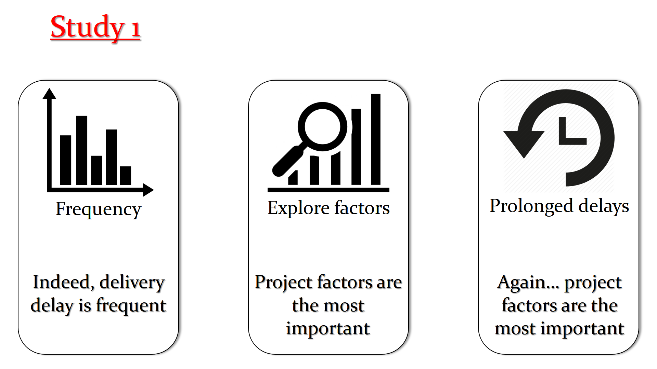

Slide 223
Study 2
vs
3.6
3.6.1
3.6.2
Comparing delivery delays
Major vs minor releases
Analyzing important factors
Rapid releases are not ‘that rapid’
Minor releases quicken the delivery time
Different prioritization

Slide 224
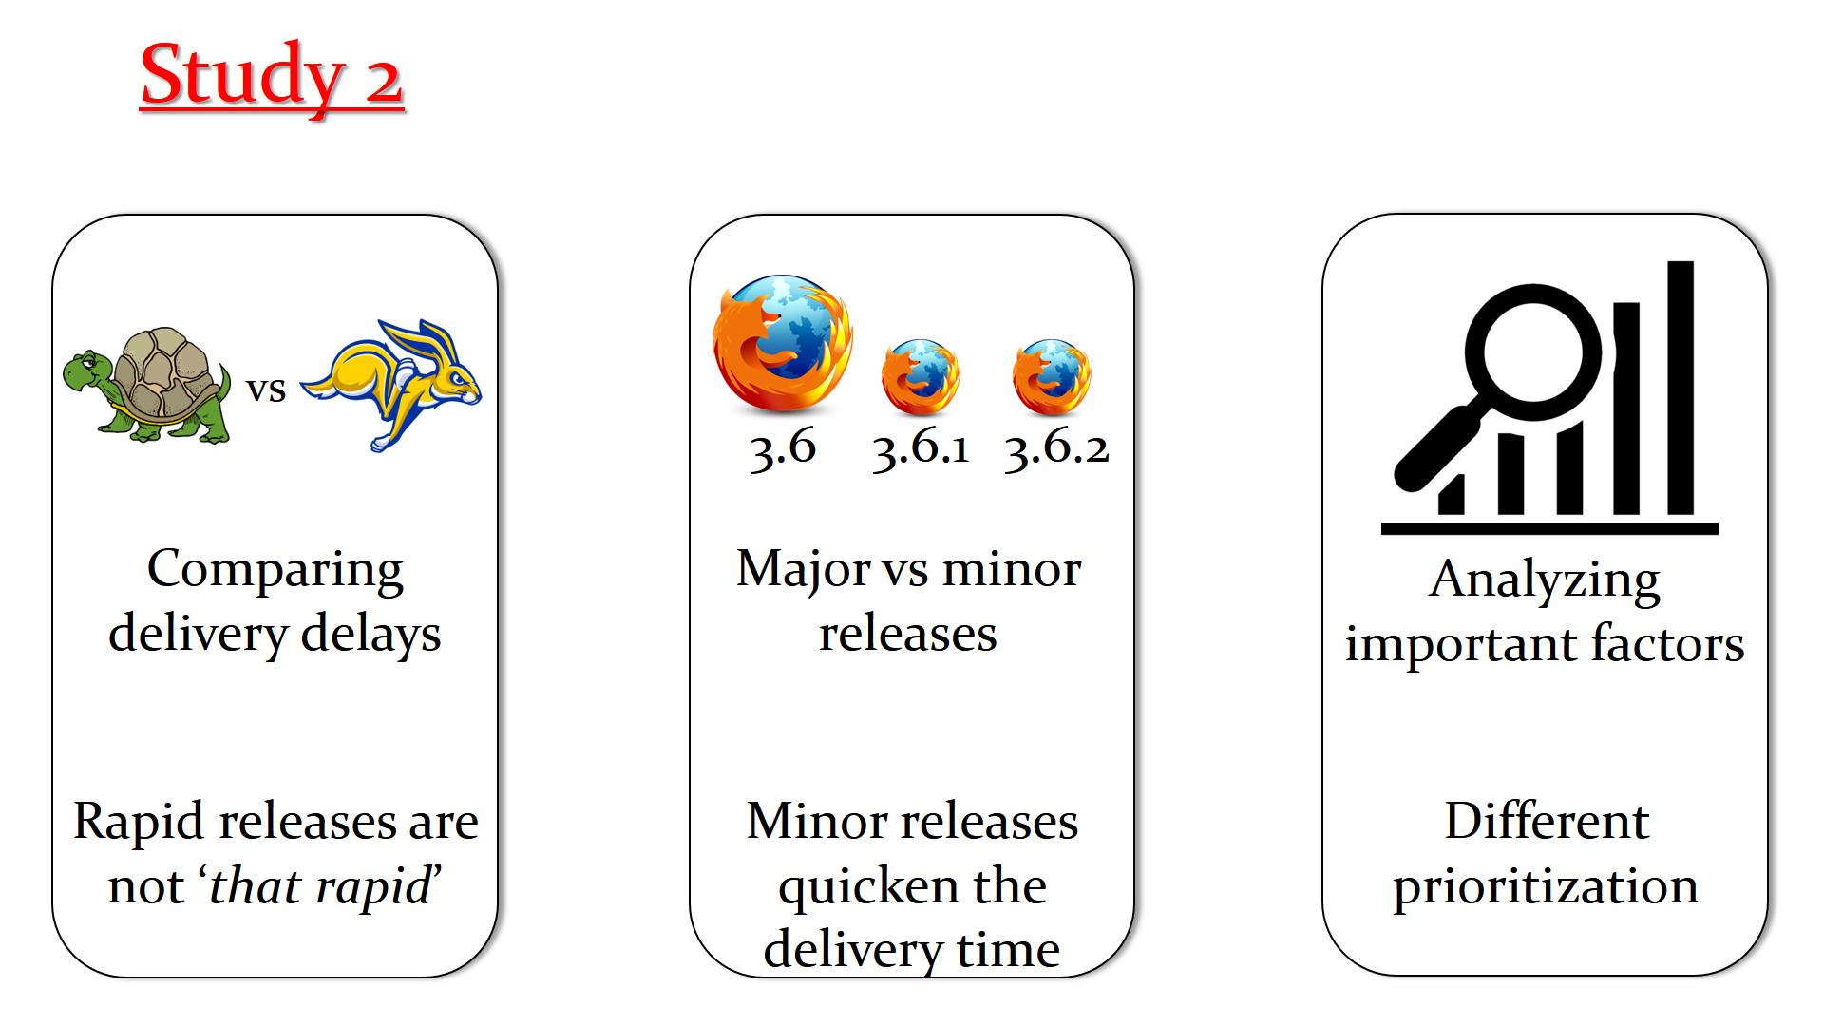

Slide 225
Study 3
General perceptions
Impressions about rapid releases
Do our findings make sense?
Decision making, frustration, risk, external teams, dev. activities
Management, delivery, development activities
Our data helped us achieving deeper insights

Slide 226
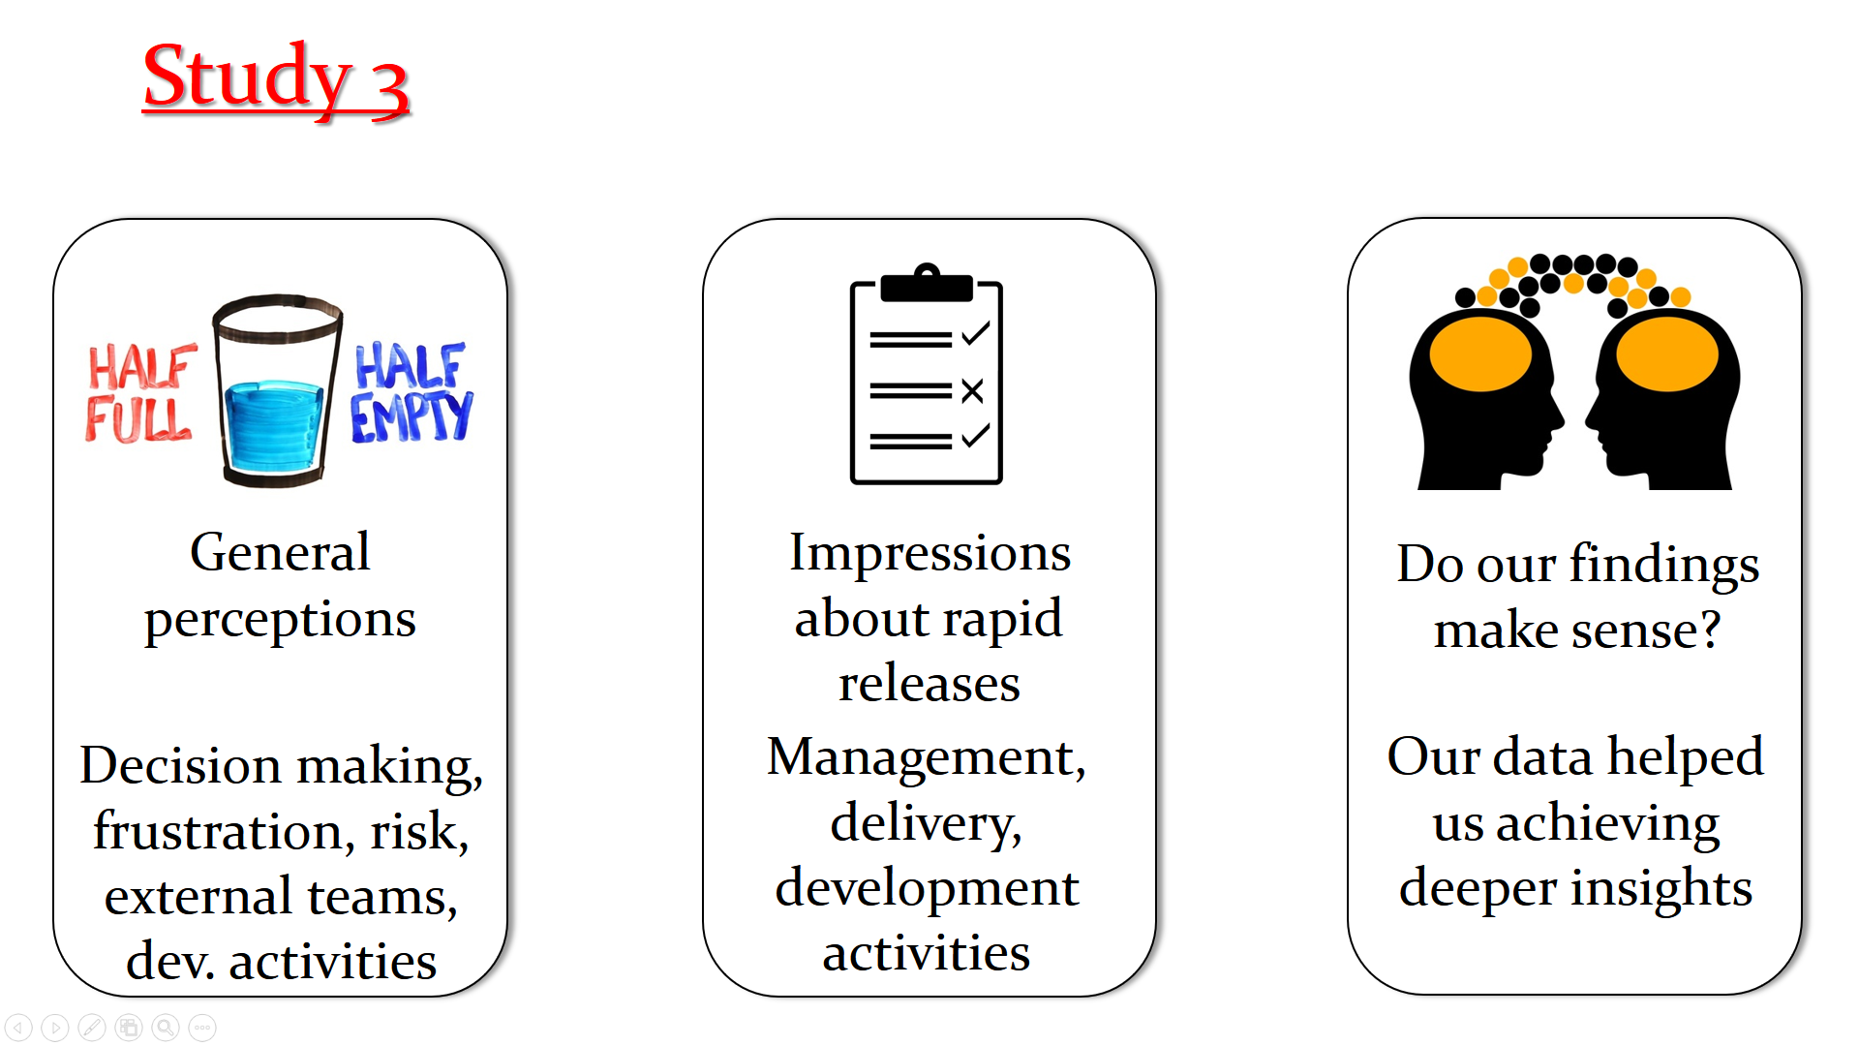

Slide 227
Thank you!

